Slide 1
DATA ANALYSIS
Measurement in GIS

Slide 2
What is spatial data?
The nature of the spatial data used has been reviewed, and the encoding and structuring of these data to produce a computer representation of the real world outlined.

Slide 3
What is analysis?
The analysis they undertake with GIS may lead, data to new information that will inform decision making.
For example, end users of a webbased mapping applications may be able to answer simple queries about the location of places of interest, or to identify shortest routes between features using mobile GIS platforms.
As a result they can make decisions about where to go next, and how to get there.

Slide 4
What is spatial analysis?
Methods for working with spatial data
  to detect patterns, anomalies
  to find answers to questions
  to test or confirm theories
    deductive reasoning
  to generate new theories and generalizations
    inductive reasoning
"a set of methods whose results change when the locations of the objects being analyzed change"

Slide 5
What is Spatial Analysis (cont.)
Methods for adding value to data
  in doing scientific research
  in trying to convince others
Turning raw data into useful information
A collaboration between human and machine
  Human directs, makes interpretations and inferences
  Machine does tedious, complex stuff

Slide 6
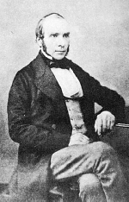
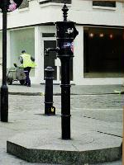

Early Spatial Analysis
John Snow, 1854
Cholera via polluted water, not air
Broad Street Pump

Slide 7
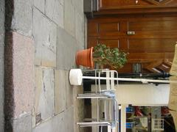
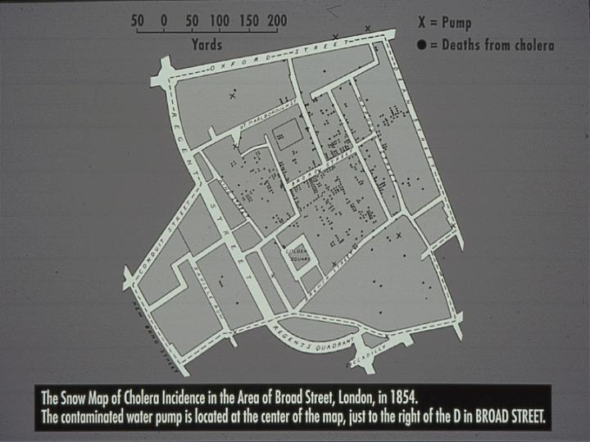
John Snow’s Map

Slide 8

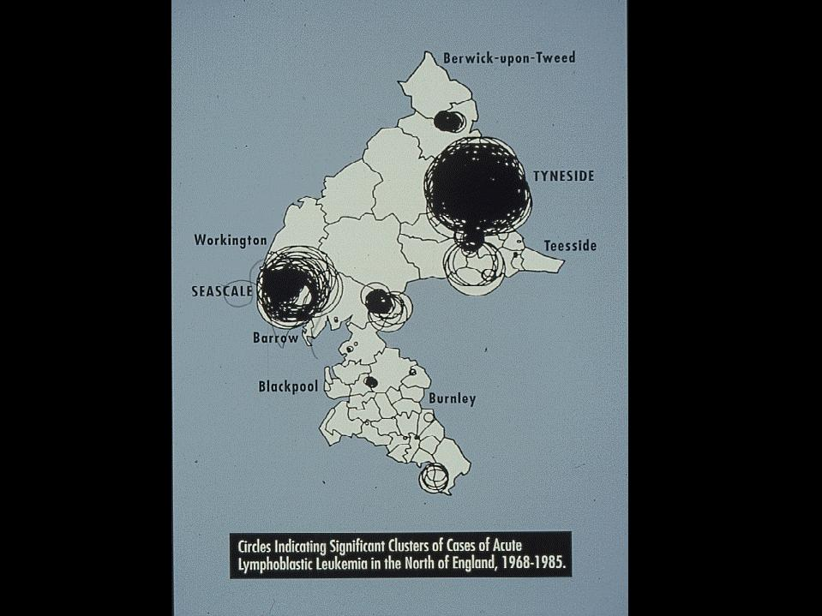
Updating Snow:
Openshaw 1965-’98
Geographic Analysis Machine
Search datasets for event clusters
  cases: pop at risk
Geographical correlates for:
  Cancer
  Floods
  Nuclear attack
  Crime

Slide 9
Objectives of Spatial Analysis
Queries and reasoning
Measurements
  Aspects of geographic data, length, area, etc.
Transformations
  New data, raster to vector, geometric rules
Descriptive summaries
  Essence of data in a few parameters
Optimization - ideal locations, routes
Hypothesis testing – from a sample to entire population

Slide 10
Answering Queries
A GIS can present several distinct views
Each view can be used to answer simple queries
  ArcCatalog
  ArcMap

Slide 11
Functions for data analysis
Functions available in most GIS packages, including
Measurement techniques
Attribute queries
Proximity analysis
Overlay operations and
Analysis of models of surfaces and networks.

Slide 12
Data analysis terminology
Entity
Attribute
Feature
Data layer
Image
Cell
Function or operation
Algorithm

Slide 13
Data analysis terminology
Entity: An individual point, line or area in a GIS database
Attribute: Data about an entity.
In a vector GIS attributes are stored in a database. For example, the street name for a line entity that represents a road may be stored.

Slide 14
Data analysis terminology
In a raster GIS the value of a cell in the raster grid is a numerical code used to represent the attribute present.
For example, code ‘1’ may be used for a motorway, ‘2’ for a main road and ‘3’ for a minor road. Further attributes of an entity (for instance street name) may be stored in a database linked to the raster image

Slide 15
Data analysis terminology
Feature: An object in the real world to be encoded in a GIS database
Data layer: A data set for the area of interest in a GIS.
For example, the Happy Valley GIS contains data layers on nine themes, including roads, ski runs, hotels and land use.

Slide 16
Data analysis terminology
Data layers in a GIS normally contain data of only one entity type (that is points, lines or areas).
It would be unusual for a data layer to contain, for instance, roads and hotels; these would be stored as separate thematic data layers

Slide 17
Data analysis terminology
Image: A data layer in a raster GIS. It should be remembered that each cell in a raster image will contain a single value that is a key to the attribute present there
Cell: An individual pixel in a raster image
Function or operation: A data analysis procedure performed by a GIS
Algorithm: The computer implementation of a sequence of actions designed to solve a problem

Slide 18
MEASUREMENTS IN GIS
Calculating measurements
  Lengths,
  Perimeters and
  Areas
Method of measurement employed in GIS.
  Raster and Vector
vector data are made up of straight line segments (even lines which appear as
curves on the screen are stored as a collection of short straight line segments)

Slide 19
MEASUREMENTS IN GIS
Raster method: all raster entities are approximated using a grid cell representation.
Normally the shortest path, or Euclidean distance, is calculated by drawing a straight line between the end points of a line, and
creating a right-angled triangle so that Pythagorean geometry can be used.

Slide 20
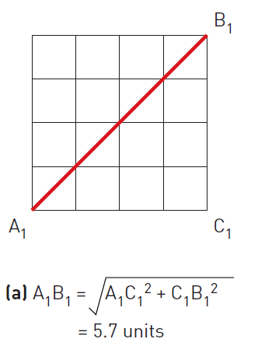
MEASUREMENTS IN GIS
In this case the distance AB is calculated using the formula:
  AB² = AC² + CB²
  AB = sqrt(AC² + CB²)

Slide 21
MEASUREMENTS IN GIS
Alternatively, a ‘Manhattan’ distance can be calculated.
This is the distance along raster cell sides
from one point to the other. The name for this method comes from the way in which you would get across a city, like Manhattan, consisting of dense ‘blocks’ of buildings. As it is impossible to pass diagonally through a block, you have to traverse the sides

Slide 22
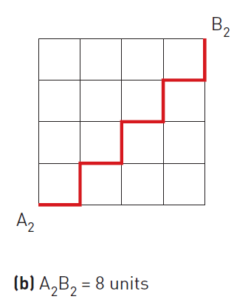
MEASUREMENTS IN GIS
‘Manhattan’ distance

Slide 23
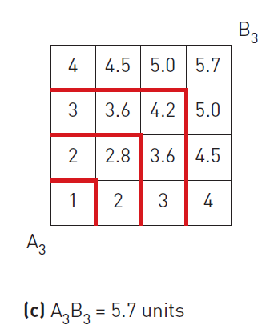
MEASUREMENTS IN GIS
A third method of calculating distance in a raster GIS uses ‘proximity’ (Berry, 1993).
In this method, concentric equidistant zones are established around the start point A.

Slide 24
MEASUREMENTS IN GIS
A third method of calculating distance in a raster GIS uses ‘proximity’ (Berry, 1993).
In this method, concentric equidistant zones are established around the start point A.

Slide 25
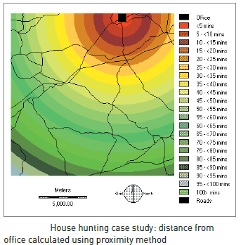
MEASUREMENTS IN GIS
‘Proximity’ method example:

Slide 26
MEASUREMENTS IN GIS
Perimeter calculation: To obtain a perimeter measurement in a raster GIS, the number of cell sides that make up the boundary of a feature is multiplied by the known resolution of the raster grid.
Area calculation: The number of cells a feature occupies is multiplied by the known area of an individual grid cell

Slide 27
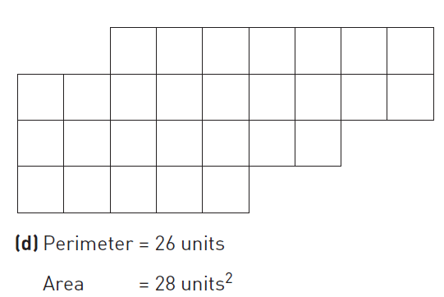
MEASUREMENTS IN GIS
Perimeter and Area calculations

Slide 28
MEASUREMENTS IN GIS
Perimeter and Area calculations

Slide 29
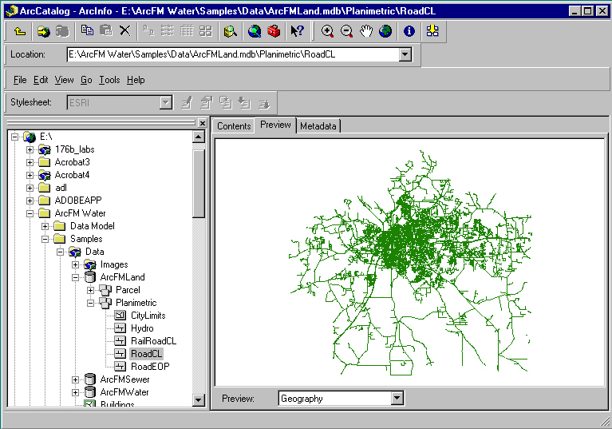
Views to Help w/Queries
hierarchy of devices, folders, datasets, files
Map, table, metadata

Slide 30
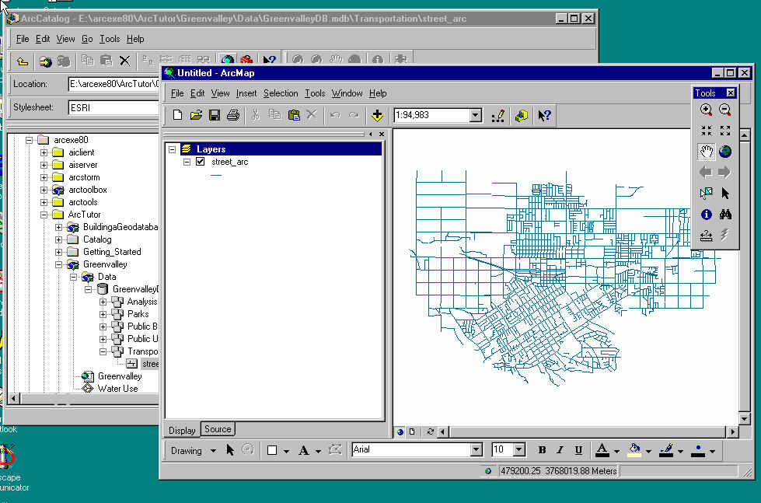
Views to Help w/Queries
ArcMap - map view

Slide 31
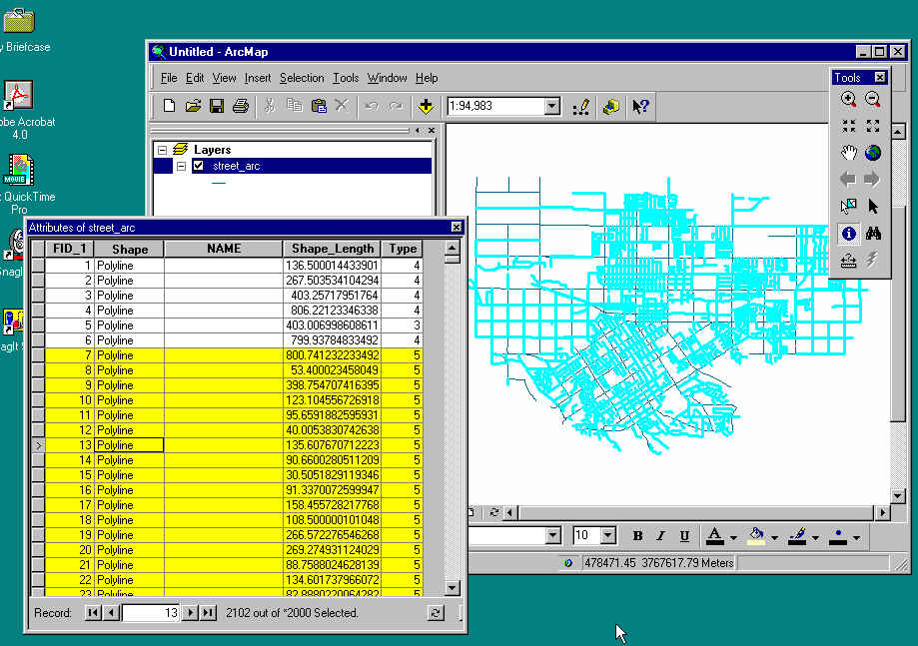
Views to Help w/Queries
ArcMap - table view linked to map

Slide 32
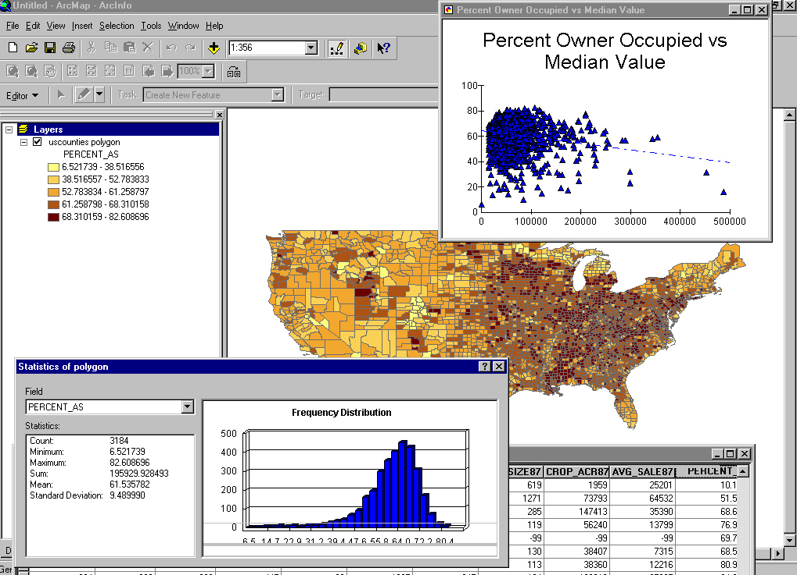
Views to Help w/Queries
ArcMap - histogram and scatterplot views

Slide 33
Exploratory Data Analysis ( EDA )
Interactive methods to explore spatial data
Use of linked views
Finding anomalies, outliers
In images, finding particular features
Data mining large masses of data
  e.g., credit card companies
  anomalous behavior in space and time

Slide 34
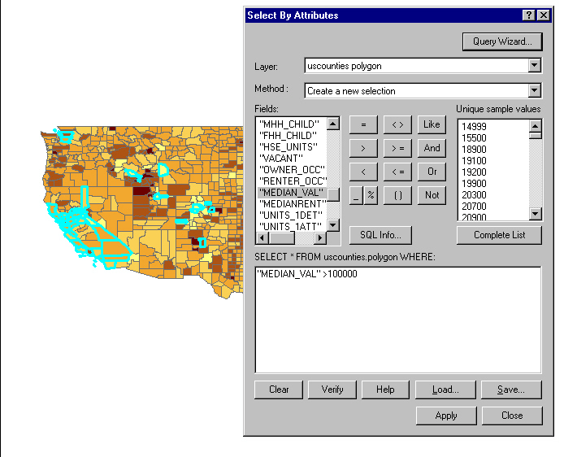
SQL in EDA
Structured or Standard query language
SELECT FROM counties WHERE median value > 100,000
Result is HIGHLIGHTed

Slide 35
Spatial Reasoning with GIS
GIS would be easier to use if it could "think" and "talk" more like humans
  or if there could be smooth transitions between our vague world and its precise world
  Google Maps
In our vague world, terms like “near”, far”, “south of”, etc. are context-specific
  From Santa Barbara: LA is far from SB
  From London: LA is right next to SB

Slide 36
Measurement with GIS
Often difficult to make by hand from maps
  measuring the length of a complex feature
  measuring area
  how did we measure area before GIS?
Distance and length
  calculation from metric coordinates
  straight-line distance on a plane

Slide 37
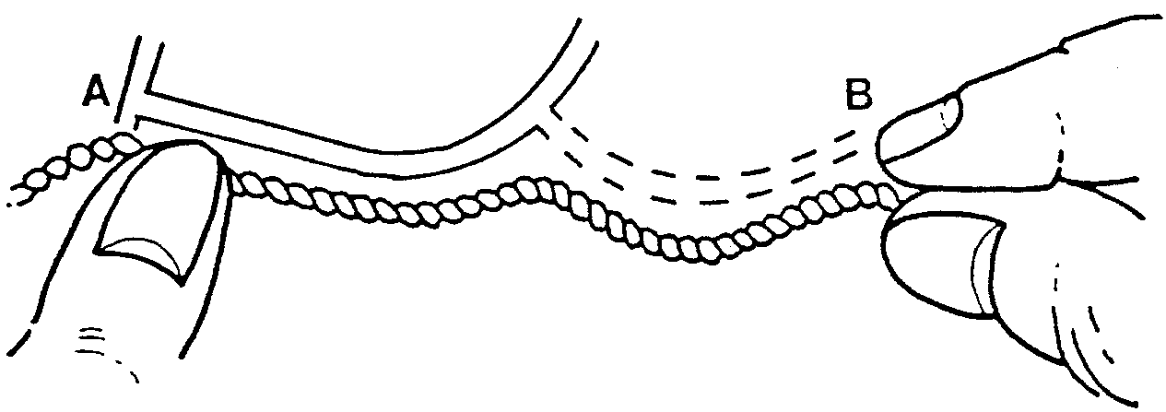
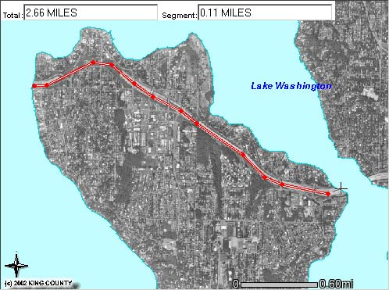
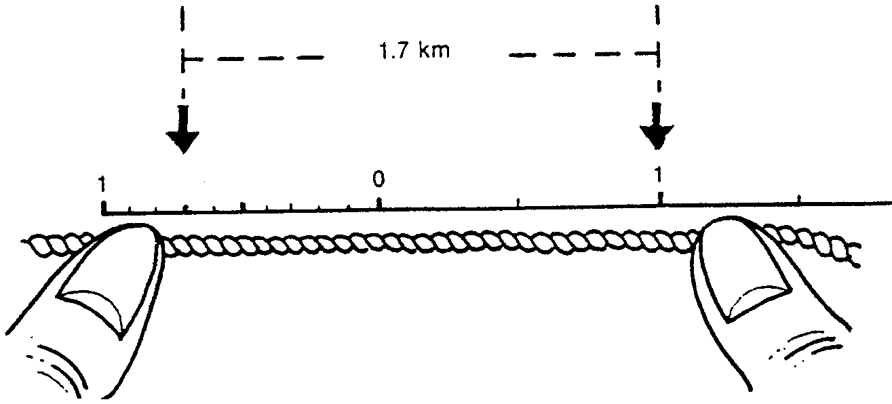
Measuring the length of a feature
vs.

Slide 38
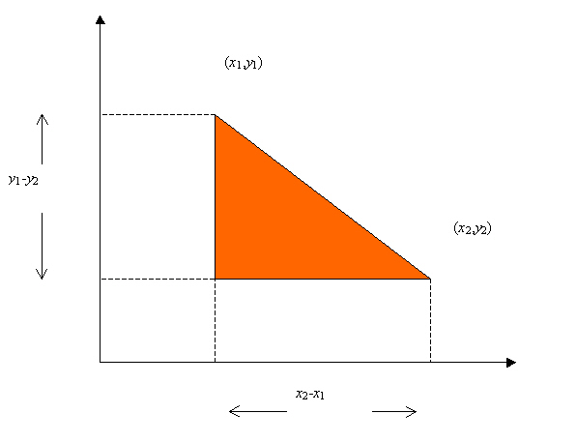
Distance
Simplest distance calculation in GIS
d = sqrt [(x₁-x₂)²+(y₁-y₂)² ]
But does it work for latitude and longitude?

Slide 39
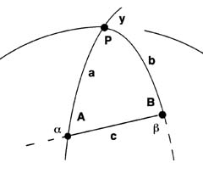
Spherical (not spheroidal) geometry
Note: a and b are distinct from A (alpha) and B (beta).
1. Find distances a and b in degrees from the pole P.
2. Find angle P by arithmetic comparison of longitudes.
  (If angle P is greater than 180 degrees subtract angle P from 360 degrees.)
  Subtract result from 180 degrees to find angle y.
  3. Solve for 1/2 ( a - b ) and 1/2 ( a + b ) as follows:
  tan 1/2 ( a - b ) = - { [ sin 1/2 ( a - b ) ] / [ sin 1/2 ( a + b ) ] } tan 1/2 y
  tan 1/2 ( a + b ) = - { [ cos 1/2 ( a - b ) ] / [ cos 1/2 ( a + b ) ] } tan 1/2 y
4. Find c as follows:
  tan 1/2 c = { [ sin 1/2 ( a + b ) ] x [ tan 1/2 ( a - b ) ] } / sin 1/2 ( a - b )
5. Find angles A and B as follows:
  A = 180 - [ ( 1/2 a + b ) + ( 1/2 a - b ) ]
  B = 180 - [ ( 1/2 a + b ) - ( 1/2 a - b ) ]

Slide 40
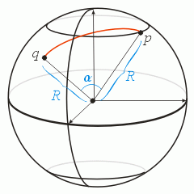
Distance
GIS usually uses spherical calculations
From (lat₁,long₁) to (lat₂,long₂)
R is the radius of the Earth
d = R cos⁻¹ [sin lat₁ sin lat₂ + cos lat₁ cos lat₂ cos (long₁ - long₂)]

Slide 41
What R to use?
Quadratic mean radius
  best approximation of Earth's average transverse meridional arcradius and radius.
  Ellipsoid's average great ellipse.
  6 372 795.48 m (≈3,959.871 mi; ≈3,441.034 nm).
Authalic mean radius
  "equal area" mean radius
  6 371 005.08 m (≈3,958.759 mi; ≈3,440.067 nm).
  Square root of the average (latitudinally cosine corrected) geometric mean of the meridional and transverse equatorial (i.e., perpendicular), arcradii of all surface points on the spheroid
Volumic radius
  Less utilized, volumic radius
  radius of a sphere of equal volume:
  6 370 998.69 m (≈3,958.755 mi; ≈3,440.064 nm).
(Source Wikipedia)

Slide 42
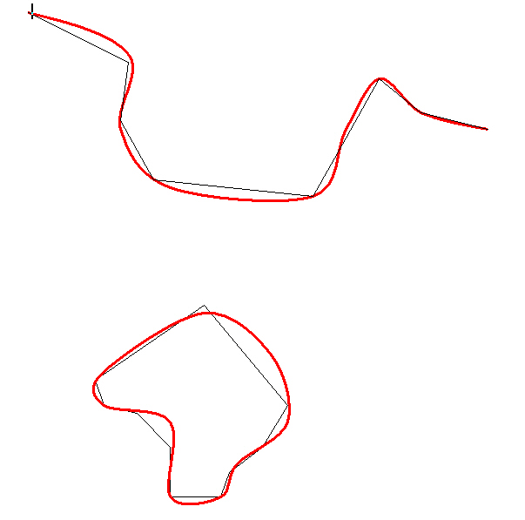
Length
add the lengths of polyline or polygon segments
Two types of distortions
  (1) if segments are straight,
  length will be
  underestimated
  in general

Slide 43
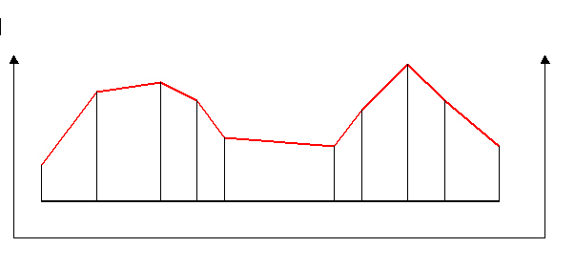
Length
Two types of distortions
  (2) line in 2-D GIS on a plane considerably
  shorter than 3-D
  Area of land parcel based on area of horiz. projection, not true surface area

Slide 44
Area
How do we measure area of a polygon?
Proceed in clockwise direction around the polygon
For each segment:
  drop perpendiculars to the x axis
  this constructs a trapezium
  compute the area of the trapezium
  difference in x times average of y
  keep a cumulative sum of areas

Slide 45
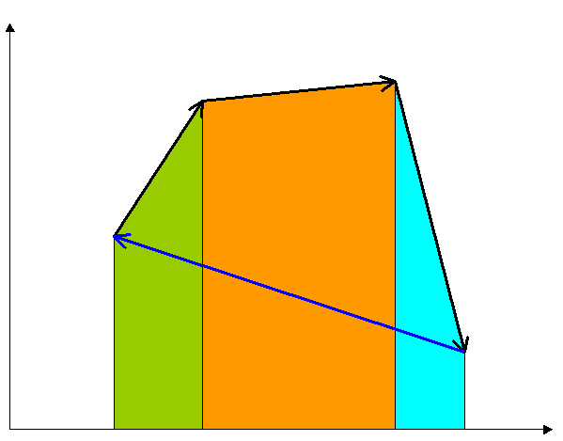
Area (cont.)
Green, orange, blue trapezia
Areas = differences in x times averages of y
Subtract 4th to get area of polygon

Slide 46
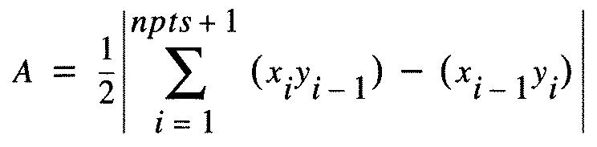
Area by formula
(x₁,y₁)=
(x₅,y₅)
(x₄,y₄)
(x₂,y₂)
(x₃,y₃)

Slide 47
Applying the Algorithm to a Coverage
For each polygon
For each arc:
  proceed segment by segment from FNODE to TNODE
  add trapezia areas to R polygon area
  subtract from L polygon area
On completing all arcs, totals
are correct area

Slide 48
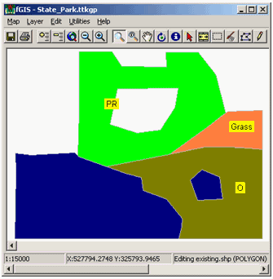
Algorithm
Area of poly - a “numerical recipe”
a set of rules executed in sequence
to solve a problem
  “islands” must all be scanned clockwise
  “holes” must be scanned anticlockwise
  holes have negative area
  Polygons can have outliers
Notes:
When might the algorithm fail?
Wrong result if area is very small and the coordinate values are very large (UTM)
Hence, you would need double precision for the calculations but not for results!

Slide 49
Shape
How can we measure the shape of an area?
Compact shapes have a small perimeter for a given area (P/A)
Compare perimeter to the perimeter of a circle of the same area [A = Π R²
So R = sqrt(A/ Π )
shape = perimeter / sqrt (A/ Π)
Many other measures

Slide 50
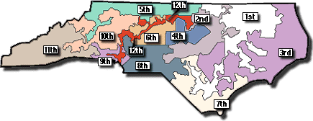
What Use are Shape Measures?
“Gerrymandering”
  creating oddly shaped districts to manipulate the vote
  named for Elbridge Gerry, governer of MA and signatory of the Declaration of Independence
  today GIS is used to design districts
After 1990 Census

Slide 51
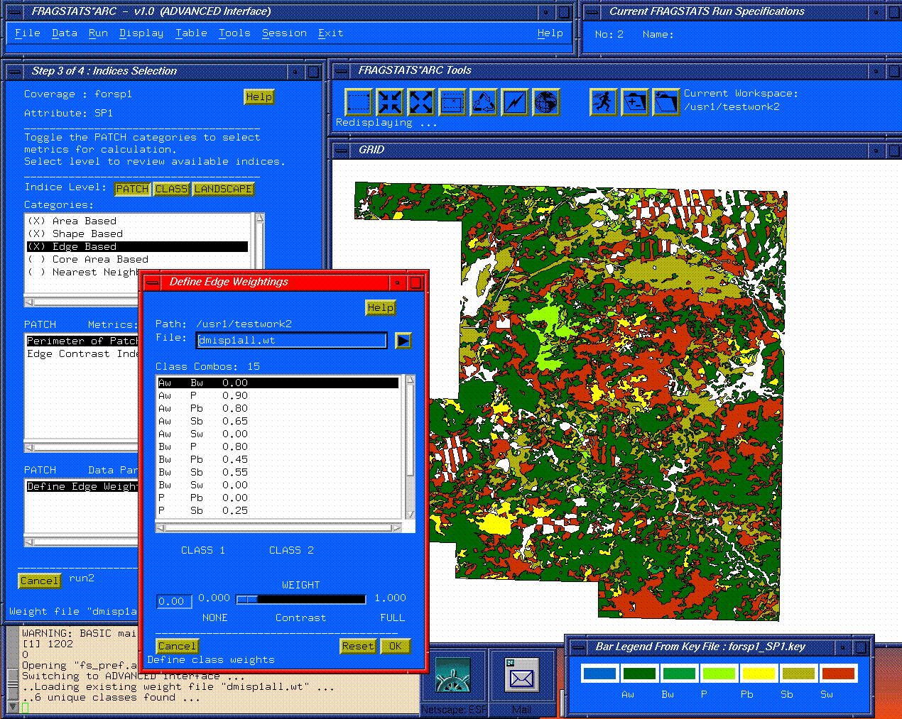
Example: Landscape Metrics

Slide 52
Slope and Aspect
measured from an elevation or bathymetry raster
  compare elevations of points in a 3x3 (Moore) neighborhood
  slope and aspect at one point estimated from elevations of it and surrounding 8 points
number points row by row, from top left from 1 to 9
1
2
3
4
5
6
7
8
9

Slide 53
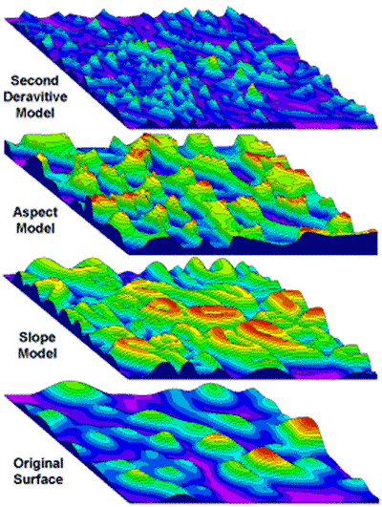
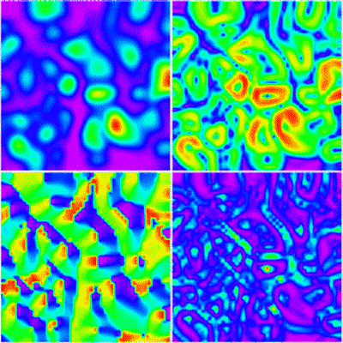
Slope and Aspect

Slide 54
Slope Calculation
b = (z₃ + 2z₆ + z₉ - z₁ - 2z₄ - z₇) / 8r
c = (z₁ + 2z₂ + z₃ - z₇ - 2z₈ - z₉) / 8r
  b denotes slope in the x direction
  c denotes slope in the y direction
  r is the spacing of points (30 m)
find the slope that fits best to the 9 elevations
minimizes the total of squared differences between point elevation and the fitted slope
weighting four closer neighbors higher
tan (slope) = sqrt (b² + c²)

Slide 55
Slope Definitions
Slope defined as an angle
… or rise over horizontal run
… or rise over actual run
Or in percent
various methods
  important to know how your favorite GIS calculates slope
  Different algorithms create different slopes/aspects

Slide 56
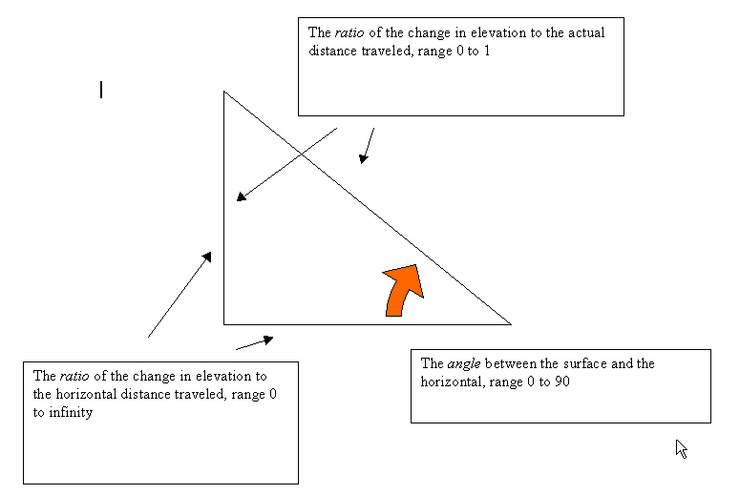
Slope Definitions (cont.)

Slide 57
Aspect
tan (aspect) = b/c
Angle between vertical and direction of steepest slope
Measured clockwise
Add 180 to aspect if c is positive, 360 to aspect if c is negative and b is positive

Slide 58
Transformations
Buffering (Point, Line, Area)
Point-in-polygon
Polygon Overlay
Spatial Interpolation
  Theissen polygons
  Inverse-distance weighting
  Kriging
  Density estimation

Slide 59
Basic Approach
Map
New map
Transformation

Slide 60
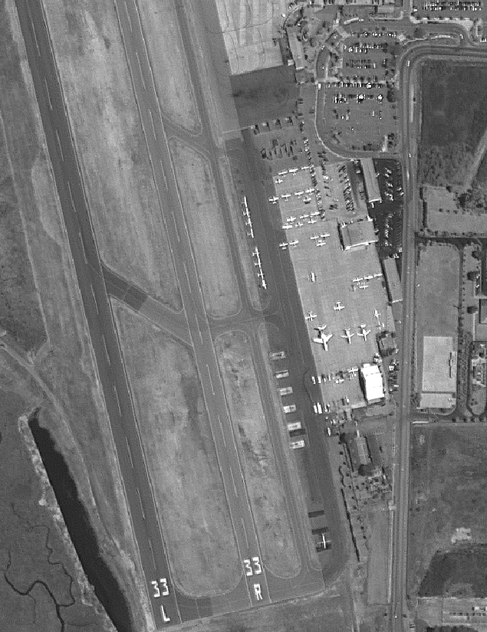
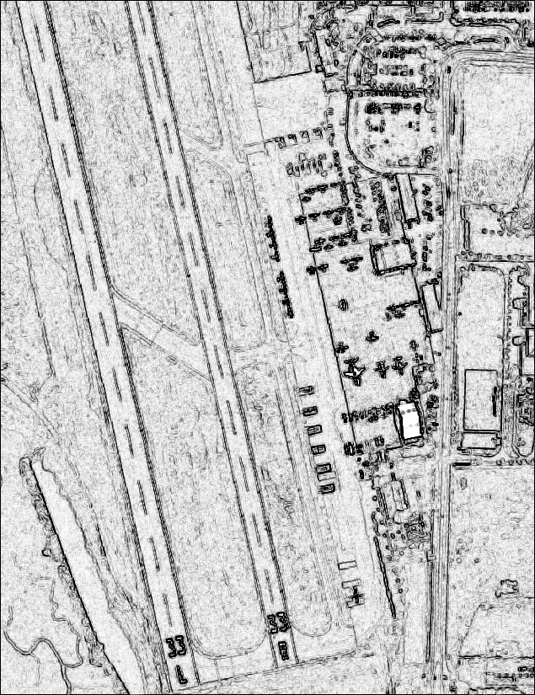
Example

